Slide 1

The Influential Assistant:
The 50th Annual Administrative Professionals Course
A message for management

Slide 2
P.A. Douglas & Associates
Much is expected of your assistant today. Good organization, management and people skills are no longer an option -- they are an imperative. At this comprehensive program, your assistant will participate in a significant learning experience with others who share the same responsibilities and face the same challenges.

Slide 3
With training budgets stretched tightly today, it is important that your assistant receive the best training and the best value. This program is a content rich, intensive three-day workshop intended to explore and develop the organizational and interpersonal abilities of each participant.
P.A. Douglas & Associates

Slide 4
P.A. Douglas & Associates
The Annual Administrative Professionals Course by P.A. Douglas and Associates is North America’s highest rated, longest running and most comprehensive annual training event for Administrative Assistants and Executive Assistants.

Slide 5
To assist you in evaluating the alternatives and cut through the hype, please consider the following five key advantages the 50th Annual Administrative Professionals Course offers:
P.A. Douglas & Associates

Slide 6
America’s Original Event for Administrative Professionals
The Annual Administrative Professionals Course by P.A. Douglas and Associates has run continuously since the 1970’s. More than 100,000 administrative professionals from virtually every major public and private organization in North America have attended in that time. The praise this course has received over the past fifty years reflects the persistent research and subsequent revision which ensures that the program is at the cutting edge.

Slide 7


Slide 8
Shell
Gulf
ARCO
Harley-Davidson
House of Seagram
Bank of America
Polaroid
Eastman Kodak
Dupont
General Electric
General Dynamics
General Mills
Dun & Bradstreet
Levi Strauss
Lever Brothers
General Motors
Ford Motor Company
Mercedes-Benz
Rolls-Royce
IBM
Xerox
Intel
Boeing
Lockheed Martin
McDonnell-Douglas
Hughes
Rockwell International
Disney
Motion Picture Industry
Universal Studios
NBC
CBS
CBC
Coca-Cola
Pepsico
Procter & Gamble
Motorola
Bristol-Myers Squibb
AT&T
Sprint
Verizon
Exxon
Chevron
Mobil Oil
Union Gas

Slide 9
Kraft
Nabisco
Dow Jones
Cedars-Sinai Medical Center
Childrens Hospital Boston
United States Government
Government of Canada
Her Majesty’s Government
Government of Sweden
Government of Uganda
Government of Kuwait
Pentagon
Dept. Homeland Security
CDC
CIA
FBI
US Army
US Navy
USAF
US Congress
NASA
State of California
State of Michigan
State of Alabama
State of Nevada
MIT
University of California
Johns Hopkins University
UC Berkeley
Princeton University
Duke University
Cal State University
ArEmbry-Riddle
Penn State
Tulane University
Tuskegee University
Smithsonian Institution
University of Illinois
University of Maine
New York City University
Texas A&M University
Los Angeles County
City of Las Vegas
City of Seattle
City of San Diego
City of Phoenix
City of Atlanta

Slide 10

P.A. Douglas & Associates
2. A Truly Limited Enrollment, Content Rich Course
This is NOT a conference in which your assistant will be crammed into a ballroom with hundreds of others, to listen to a keynote speaker and be lectured to. Nor, will they be forced to engage in skits, line-dancing or other nonsense. The Influential Assistant: The 50th Annual Administrative Professionals Course is a content rich educational workshop in which real and meaningful skills are taught.

Slide 11
P.A. Douglas & Associates
3. A Certified Course
We use the university standard; our courses are taught by qualified faculty not scripted presenters. All of our faculty members hold, as a minimum, a Masters Degree from a fully accredited university and one or more professional qualifications, (Ph.D., CMC, JD, PMP, etc.) Our faculty also have at least 12 years experience in their field of expertise. Being certified, in addition to your assistant will receive 2.2 continuing educational units (CEU’s).

Slide 12
P.A. Douglas & Associates
4. An all-Inclusive Package – Accommodation
and Meals Included
At P.A. Douglas we provide an all inclusive, first-class learning experience. The course fee of $2,895 includes tuition, accommodation (room & taxes) breakfast each day, luncheon on day two, refreshments, comprehensive courseware package, as well as an individual password for online materials to assist your assistant after the course is over. In assessing our fee, it should be recognized that accommodation, meals and taxes are included in our fee. This represents more than $1,000. At other courses, these costs must be incurred separately and are often more than the rates we have negotiated.

Slide 13
P.A. Douglas & Associates
5. Highest Training Return-On-Investment
We know your assistant’s time is valuable, therefore rather than endless group discussions and navel-gazing, your assistant will leave this carefully tailored, content rich program with NEW practical skills that will immediately enhance her or his management, organizational, decision-making and interpersonal skills.
The focus is on increasing your assistant’s value to you and your organization.

Slide 14
P.A. Douglas & Associates
A few comments from past participants
“This is the Cadillac, no, the Rolls-Royce of Administrative Professional programs. Everything about the course is first-class – the hotel, materials, meals, refreshments and above all the faculty. Paul Douglas is the BEST speaker I have ever heard – bar none. I learned so much, made wonderful new friends, relaxed and renewed my commitment to my company in superb surroundings. This course is expensive, but you get what you pay for. It meant so much to me that my boss thought I was worth the very best.”
— Lorna Whitman, Victory Co.

Slide 15
P.A. Douglas & Associates
A few comments from past participants
“The seminar content was substantive, which I appreciated at this level of my career. The skills I learned will enable me not only to enhance my role within the agency, but also perform as a more capable liaison for my boss”
— Teri Lyn Perreira, Wisconsin Investment Board
“I enjoyed the entire experience. I would provide constructive criticism if I could think of something, however, this seminar has surpassed any and all of my expectations. I loved it!”
— Georgelaine Milot, Novatel Inc.
“Tom Douglas is the best presenter I’ve ever seen. Clear communication, fun and uses humor. Is engaged with the audience. I would highly recommend him to others!”
— Maria Turski, Marriott Hotels

Slide 16
P.A. Douglas & Associates
A few comments from past participants
“Despite the length of the seminar, there was not a single boring moment. Paul Douglas uses his experiences and a wonderful sense of humor to keep the interest. The quality of the seminar itself was
outstanding.”
— Marie Lynch, Sunstrand Corporation
“Both Dr. Douglas and his son Tom have an excellent ability to captivate and keep you interested and motivated throughout the conference They gave me indispensable tools to succeed.”
— Suzanne Brisebois, Privy Council Office

Slide 17
P.A. Douglas & Associates
This course will benefit your assistant, your organization and yourself, by:
Enhancing productivity
Providing your assistant with new organizational skills
Increasing overall performance and effectiveness
Anticipating your needs thereby developing a greater partnership
Promoting greater teamwork by handling interpersonal conflicts with agility and diplomacy
Motivating others to set goals that achieve greater results
Protecting your – the manager's time
increase job satisfaction and thereby employee retention

Slide 18
Specifically at The Influential Assistant:
The 50th Annual Administrative Professionals Course your assistant with develop two essential sets of skills:

Slide 19
P.A. Douglas & Associates
The People Skills
The most frustrating limitations placed upon your administrative professional has little to do with her or his technical abilities; rather the most trying aspects of their work often involves dealing with people. To be really effective in dealing with others, thereby maintaining the professional environment your office requires, your assistant must develop the ability to:
Establish greater trust and rapport with others
Achieve greater team synergy and effectiveness
Inspire juniors to take initiative
Cope with different and sometimes difficult people
Deal effectively with negativity in the work place
Become a more effective team leader
Learn to proactively deal with conflict
Deal with interpersonal problems that threaten team cohesiveness
This course will benefit your assistant, your organization and yourself:

Slide 20
P.A. Douglas & Associates
The Self-Management Skills
Success as an administrative professional is dependent on a number of self- management skills. By improving your assistant’s skills at managing projects, priorities and deadlines more effectively, while deflecting job-related stress, and developing your memory and concentration; he or she will gain a deeper sense of satisfaction and accomplishment. Specifically, at the 50th Annual Administrative Professionals Course, your assistant will learn how to:
Apply best practices for effectively prioritizing time and activities
Better juggle people, paper, projects and priorities
Protect your – the boss’s time
Develop strategies for preventing, reducing, and managing stress
Anticipate and deal proactively with the boss’s needs
Enhance your ability to act more proactively and with greater independence
Recognize and eliminate boss/assistant problems

Slide 21
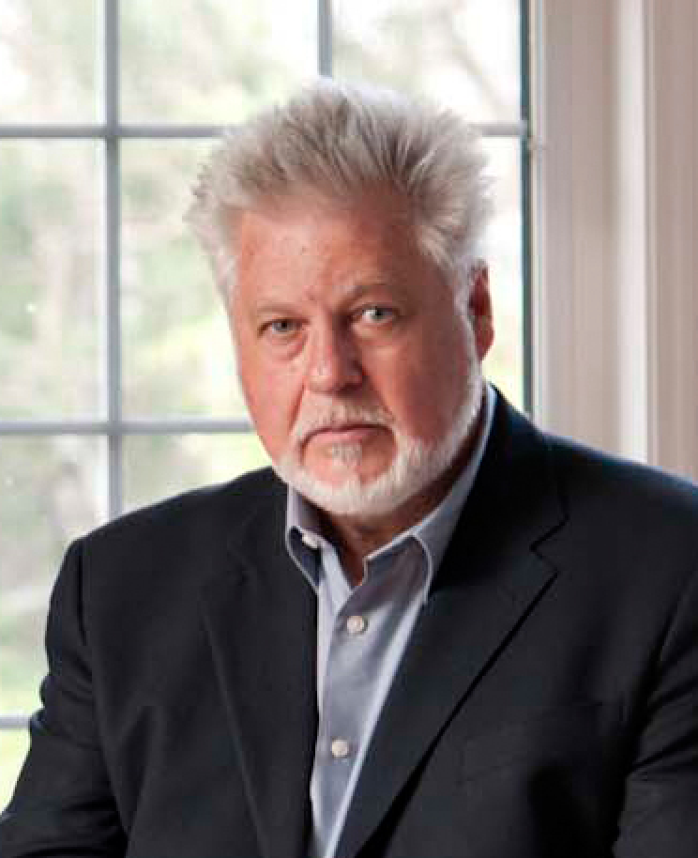
For more than forty years, we have worked closely with HR departments, executives, managers and administrative professionals themselves to ensure that our training programs meet the rigorous needs of our participants. It is from this extensive experience that we have crafted our programs. The praise our programs have received over the past five decades reflects the persistent research and subsequent revision which ensures that our courses is at the cutting edge. Your assistant’s time is too valuable to waste. I guarantee you the very best training available today.
Paul A. Douglas Ph.D
President

Slide 22
REGISTER NOW
www.canadaap.ca
or call
1-800-222-4062

